Slide 1
Shaw – A Programmer’s language
Team 7
Jayanth reddy - 1209270448
Meng – jung lin - 1209373565
Nithya kogaleru - 1209379935

Slide 2


Language design
Syntax is an amalgam of Java and Python.
Inspiration from Java → Code structure.
Inspiration from Python → No semi colons, no requirement to have a main function.
Compiler written in Java.
Run time written in Python.

Slide 3
Why shaw?
Shaw is an abbreviation of “Shadow”.
The language is inspired from Python and Java.
Acts as a shadow to both the languages and hence the name.
Source file extension:
Syntax = Filename.shaw

Slide 4
Features of the language
Data types supported → int
boolean
string
Control structure → if – else construct
while loops
Functions → 0 or more arguments
Recursion

Slide 5
WHAT MAKES SHAW UNIQUE
Programming language for programmers
Just like COBAL for business operations
Provides an option of viewing runtime behaviour

Slide 6
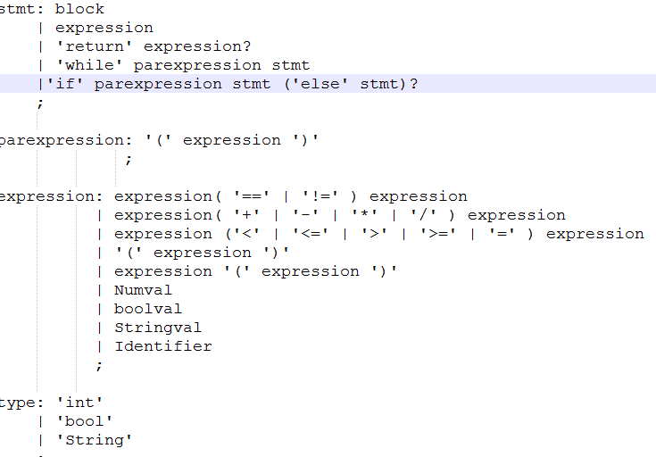
Grammar snapshot

Slide 7
Lexical analyzer
Antlr is used for lexical analysis.
It is implemented in Java.
Generates predicated – LL(k) lexers.
Identifiers → [a-zA-Z$_][a-zA-Z0-9$_]*
Integers →[0-9]+
Comparison operators: ==, !=, <, <=, >, >=, =
Brackets and parenthesis.
Skipping characters → WS: [\n\t\r]+

Slide 8
parsing
Implemented a recursive descent parser.
Reads the tokens from the scanner.
Looks for phrases in the grammar in a top down fashion.

Slide 9
Compiler
Built on top of recursive descendent parser.
Parses each node and performs its corresponding operation when encountered.
Generated intermediate code and appends it on list.
Produces the list to .txt files to store the output.

Slide 10
Source code → intermediate
Source Code (Shaw)
Generate parse tree (Antlr)
Check with grammar
(Antlr →g4)
Generate Intermediate Code (.txt)
Evaluate the tree

Slide 11
Runtime
Written in python.
Stack and 3 registers
Stores the intermediate code as an array of lines
Used hasattr & getattr to check and call the function
A separate block is written to identify and check individual blocks.

Slide 12
Intermediate →Runtime → Output
Intermediate Code (.txt)
Output
Runtime
(.py)

Slide 13
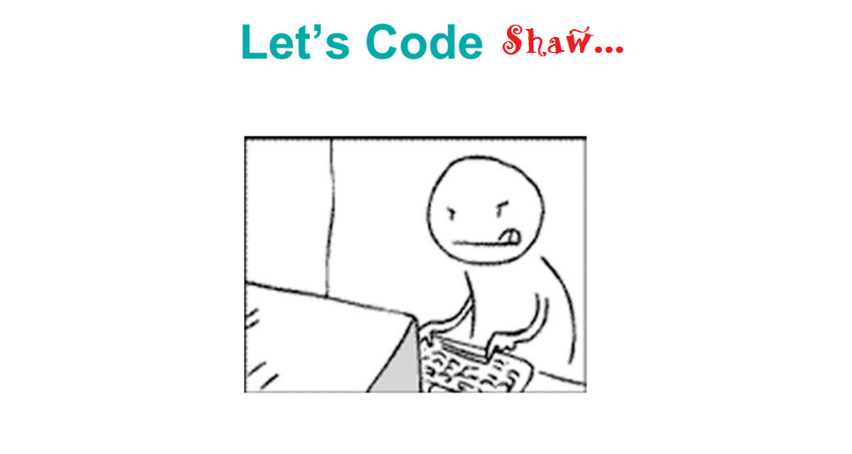
SHAW IN ACTION…

